Slide 1
WELCOME to the 24th MONTHLY
BUILDING ELECTRIFICATION WEBINAR
(Steve Miller is host A recording and the slides are on-line for later review
https://climate.smiller.org/50x30/building-electrification/All-heat-pump-webinars.html
Overview of Why Electrification Makes Financial Sense
Review of Ken’s Need for a New Furnace and A/C
Selection of HVAC Vendors
Analysis of Bids Received
Discussion by Ken (Parsippany, NJ)
and Chris Wisniewski, ICS (Metro NYC / Northern NJ )
Q&A – Pat Miller, host
Review of IRA Incentives (as time is available)
SPONSORS: NJ 50x30 Building Electrification; Sierra Club, NJ Chapter, and other environmental organizations Jan 18, 2024

Slide 2
Electric Heat Costs Less, Pollutes Less
2022 ENERGY COSTS
 | ACTUAL with heat pump | CALCULATED (no heat pump) | % CHANGE with heat pump | With Heat Pump
TOTAL Gas + Electric* | $2441 | $3153 | (23%) | Savings
GAS Cost | $394 | $1681 | (77%) | Reduction
ELECTRIC Cost | $2047 | $1472 | 39% | Increase
THERMS Gas Burned | 201 | 1163 | (83%) | Savings
TONS CO₂ Emitted** | 1.2 | 6.8 | (83%) | Savings
* 2022 Gas and electric costs include ALL uses for Miller household 2
202 * 2023 gas and electric costs and CO2 will be lowered by new heat pump water heater
*2024 electricity is 100% clean AND 21% lower cost, supplied by nearby Community Solar
Notes:
I will breeze thru quickly, because the material is covered in depth in previous webinars.

Slide 3
UUCMC REDUCTIONS IN CO₂ AND UTILITY BILL
2003 - 2019 insulated, sealed, LED bulbs, heat pump water heater,…
2021 - 2022 6 furnaces replaced with heat pumps;
+ installed large rooftop solar array
YEAR | GAS CO₂ Tons | ELECTRIC CO₂ Tons | TOTAL CO₂ Tons | % TOTAL CO₂ REDUCTION | ELECTRIC KwH from GRID | TOTAL BILL GAS+ELECTRIC | % TOTAL BILL REDUCTION
2003 | 49 | 21 | 70 |  | 72.4 | $22.1K
2019 | 26 | 10 | 36 | 49% | 32.8 | $12.4K | 44%
2023 (est) | 13 | 2 | 15 | 79% | 7.0 | $4.3K | 81%
Notes:
The total reductions you see here in red for one large church are caused in large part by the replacement of 6 gas furnaces with heat pumps, AND by the installation of rooftop solar to run the heat pumps and everything else

Slide 4
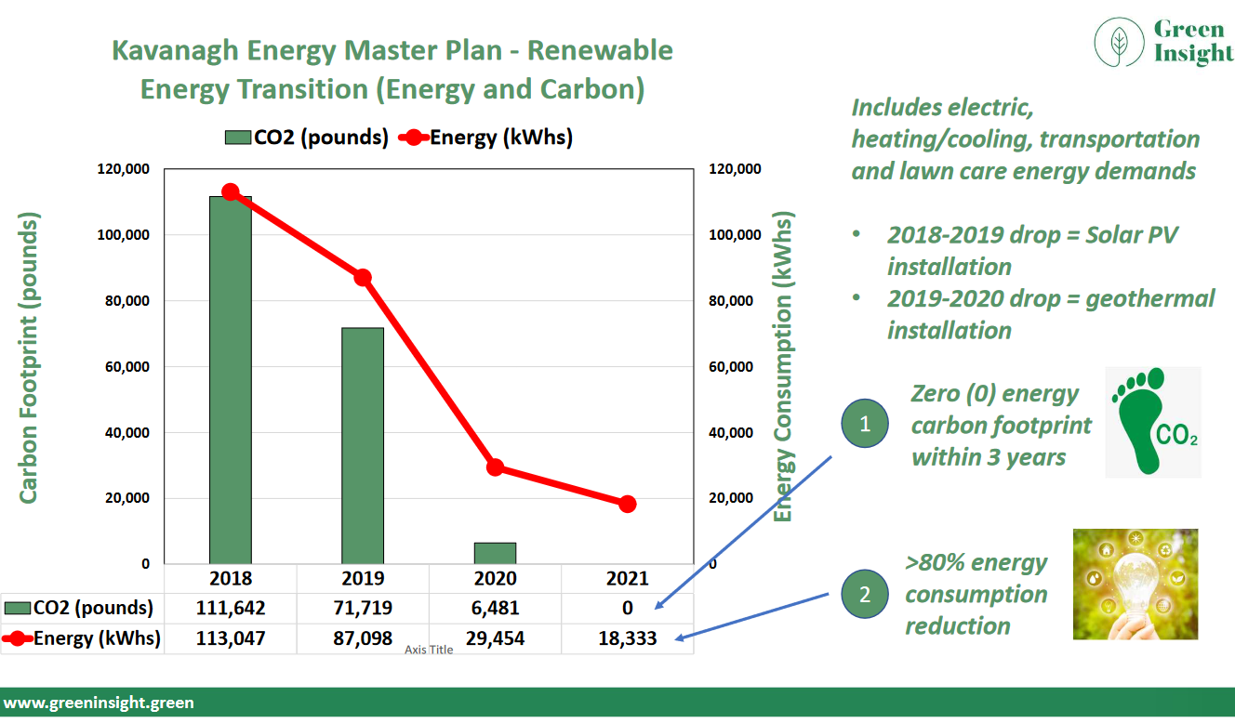
Notes:
The entire webinar on Nov 16, 2023 was about PLANNING for Building Electrication- This included conversion of vehicles to EVs, installation of rooftop solar, and use of battery-powered lawncare equipment. Matt Kavanagh’s business “Greeninsight.green” provides a consultation/planning service to help create a plan and milestones to achieve your goals. Here is the result for Matt’s own house and vehicles:
He now has 0 energy carbon footprint
And has Reduced his energy consumption 80%

Slide 5
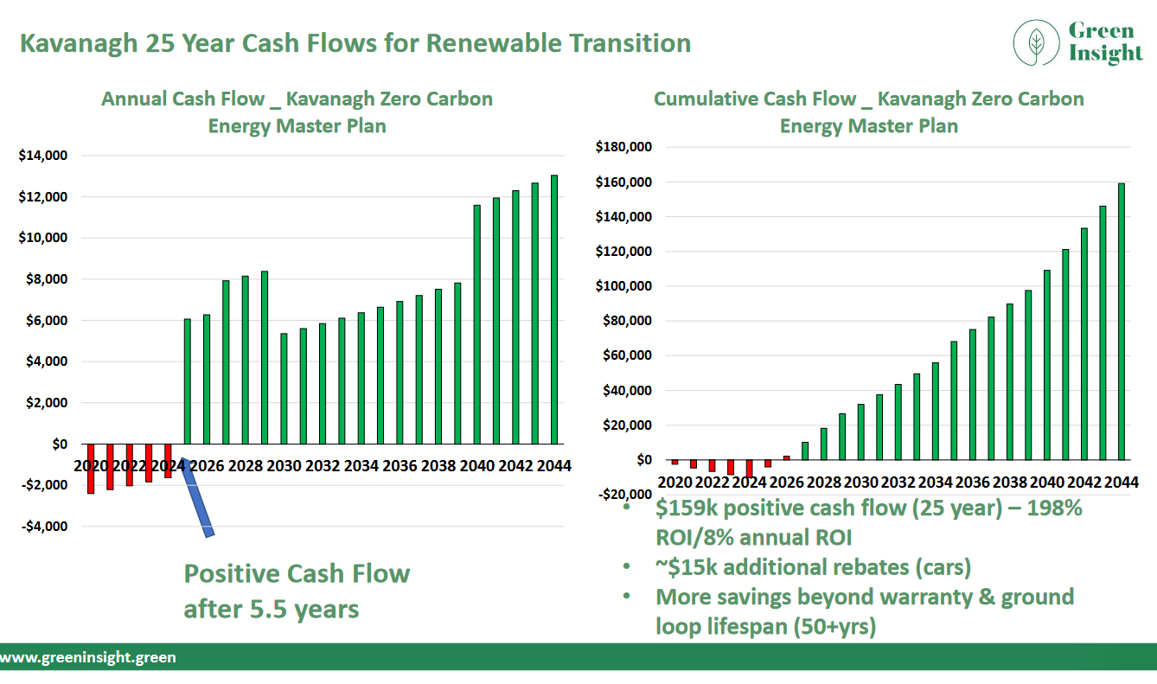
Notes:
AND, he had a positive cash flow after 5 years,
AND anticipates $159K positive cash flow in 25 years This is 200% total ROI, and 8% annual Return on Investment.

Slide 6
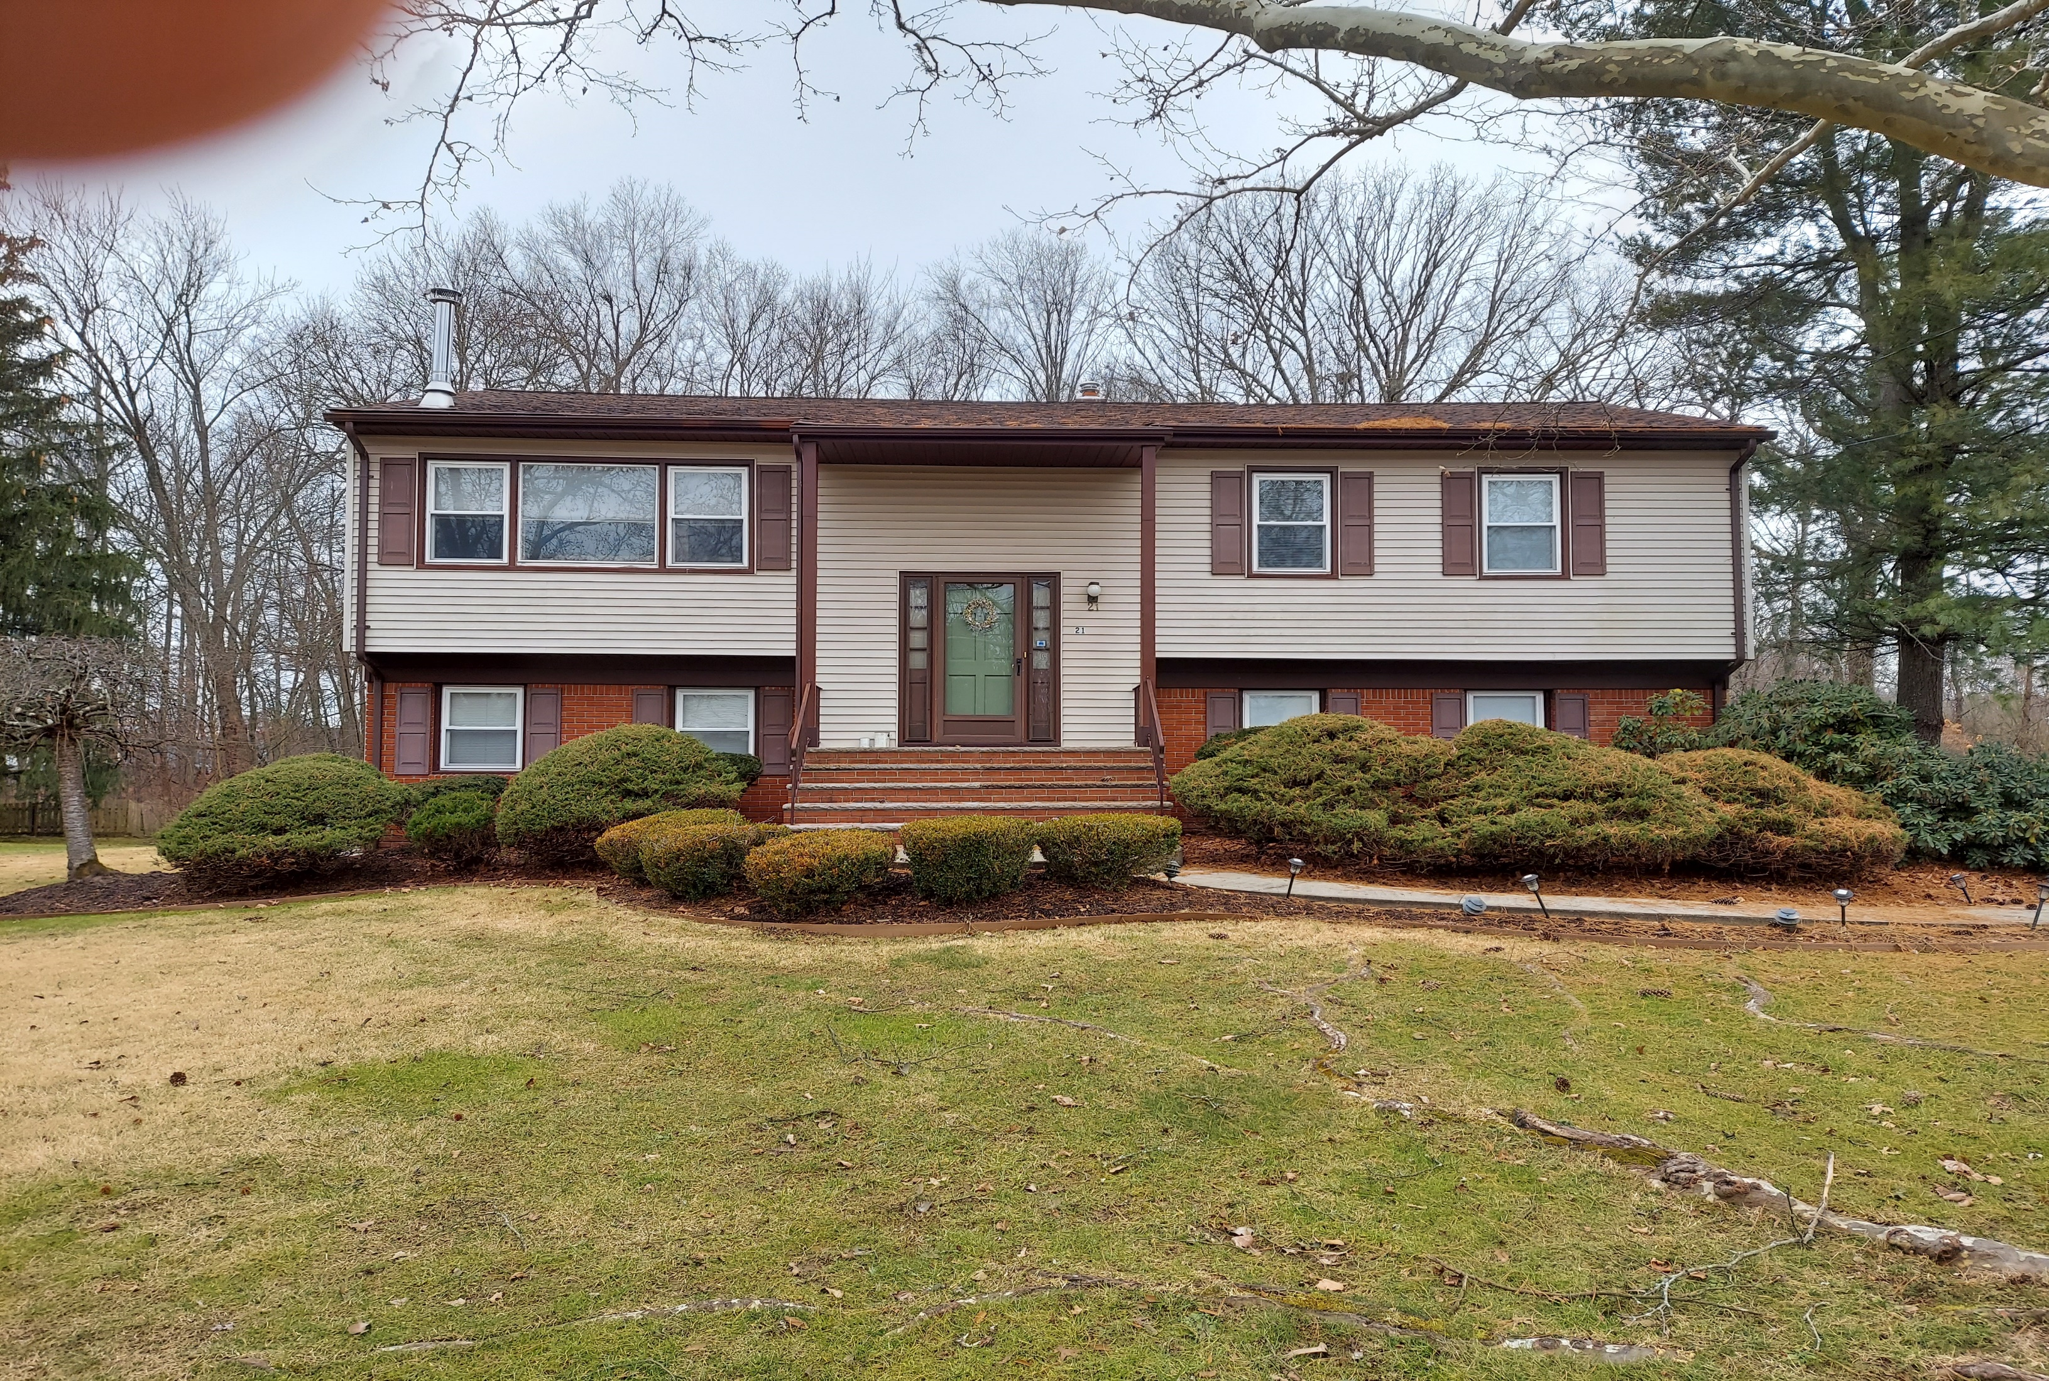
Notes:
Tonight we are concentrating on this great-looking bi-level home in Parsippany, NJ

Slide 7
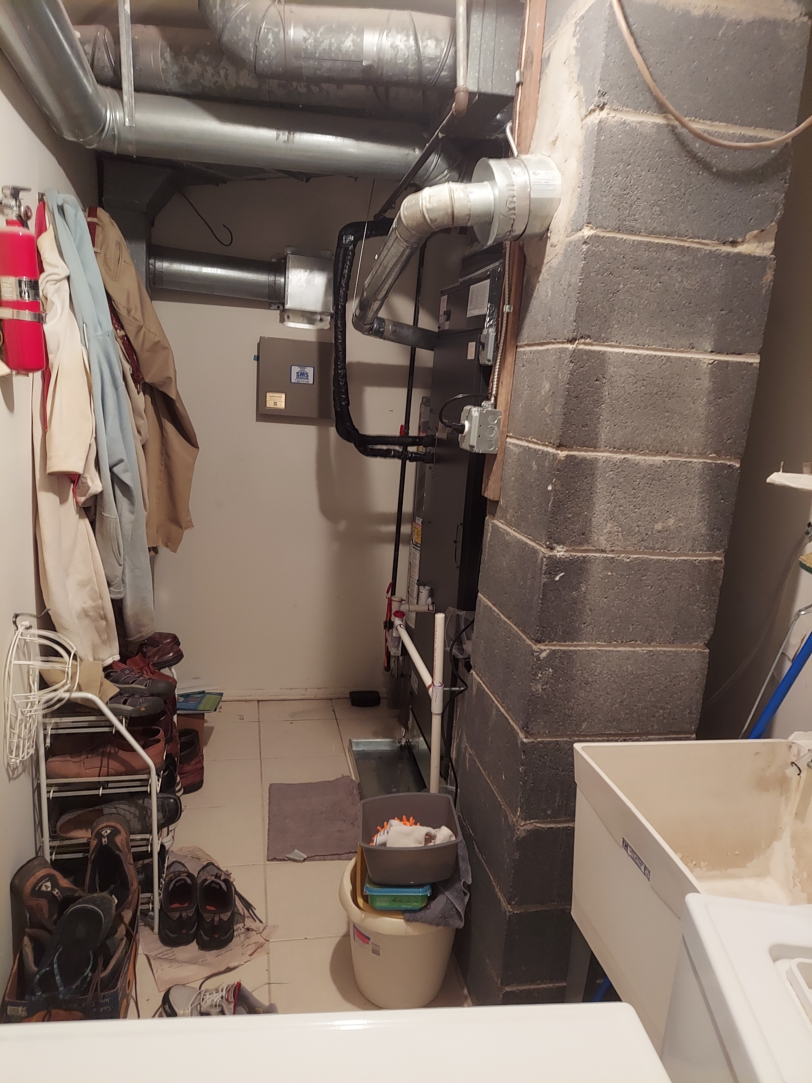
Notes:
Deep inside, we see this small furnace closet (the house does not have a basement)

Slide 8
Christopher Halasz, Comfort Advisor, (July, 2023) (Amana products + Bosch)
$21327 | 3 ton 17.2 SEER2 2 stage AC + 96% variable speed gas furnace
$20178 | 3 ton 15.2 SEER2 1 stage AC + 96% variable speed Furnace
$16628 | 3 ton 17.2 SEER2 AC + 80% 2-stage furnace
$15646 | 3 ton 15.2 SEER2 AC + 80% 2 stage furnace
$12669 | 3 ton 13.4 SEER2 AC + 80% 1 stage furnace
$2200 | Bosch Heat Pump w/inverter (“works in weather conditions under 35 degrees”)
Notes:
Ken solicited bids for his AC and furnace upgrades. Here are rounds 1 and 2.. Prices ranged from $13K to $21K
When Ken pushed further for a heat pump solution, the vendor dropped the ACs, and substituted an ADDITIONAL $2.2K Bosch Heat Pump “works in weather conditions under 35 degrees” Later you will see my analysis: The Bosch heat pump works (in Ken’s house) at ambient temperatures above 33 degrees F. Below 33 degrees, a large 52K BTU/hour gas furnace supplies all the heat.

Slide 9
Christopher Halasz, Comfort Advisor, (July, 2023) (Amana products + Bosch)
 | Amana HEAT PUMPS:
$16814 | 3.5 ton 15.2 SEER2 80K BTU 80% furnace/single stage
$21743 | 3.5 ton 15.2 SEER2 + 80K BTU 96% 1 stage furnace
$1123 | Heat strip (for under 35 degree temps)
Notes:
And when Ken asked for more input on heat pumps, he was give these proposals for 3.5 ton Amana HEAT PUMPS.
BUT HOW IS A LAYMAN SUPPOSED TO DECIDE??
The analysis on the next two slides shows that the Amana heat pump must be supplemented by auxiliary heating when the ambient drops below 23 degrees. In this case, the auxiliary heat source (a heat strip using inefficient electric resistance heating) must provide 20K BTU/hour (about 6 KW/hour at the design temperature of 10 degrees F ambient in Parsippany, NJ.

Slide 10
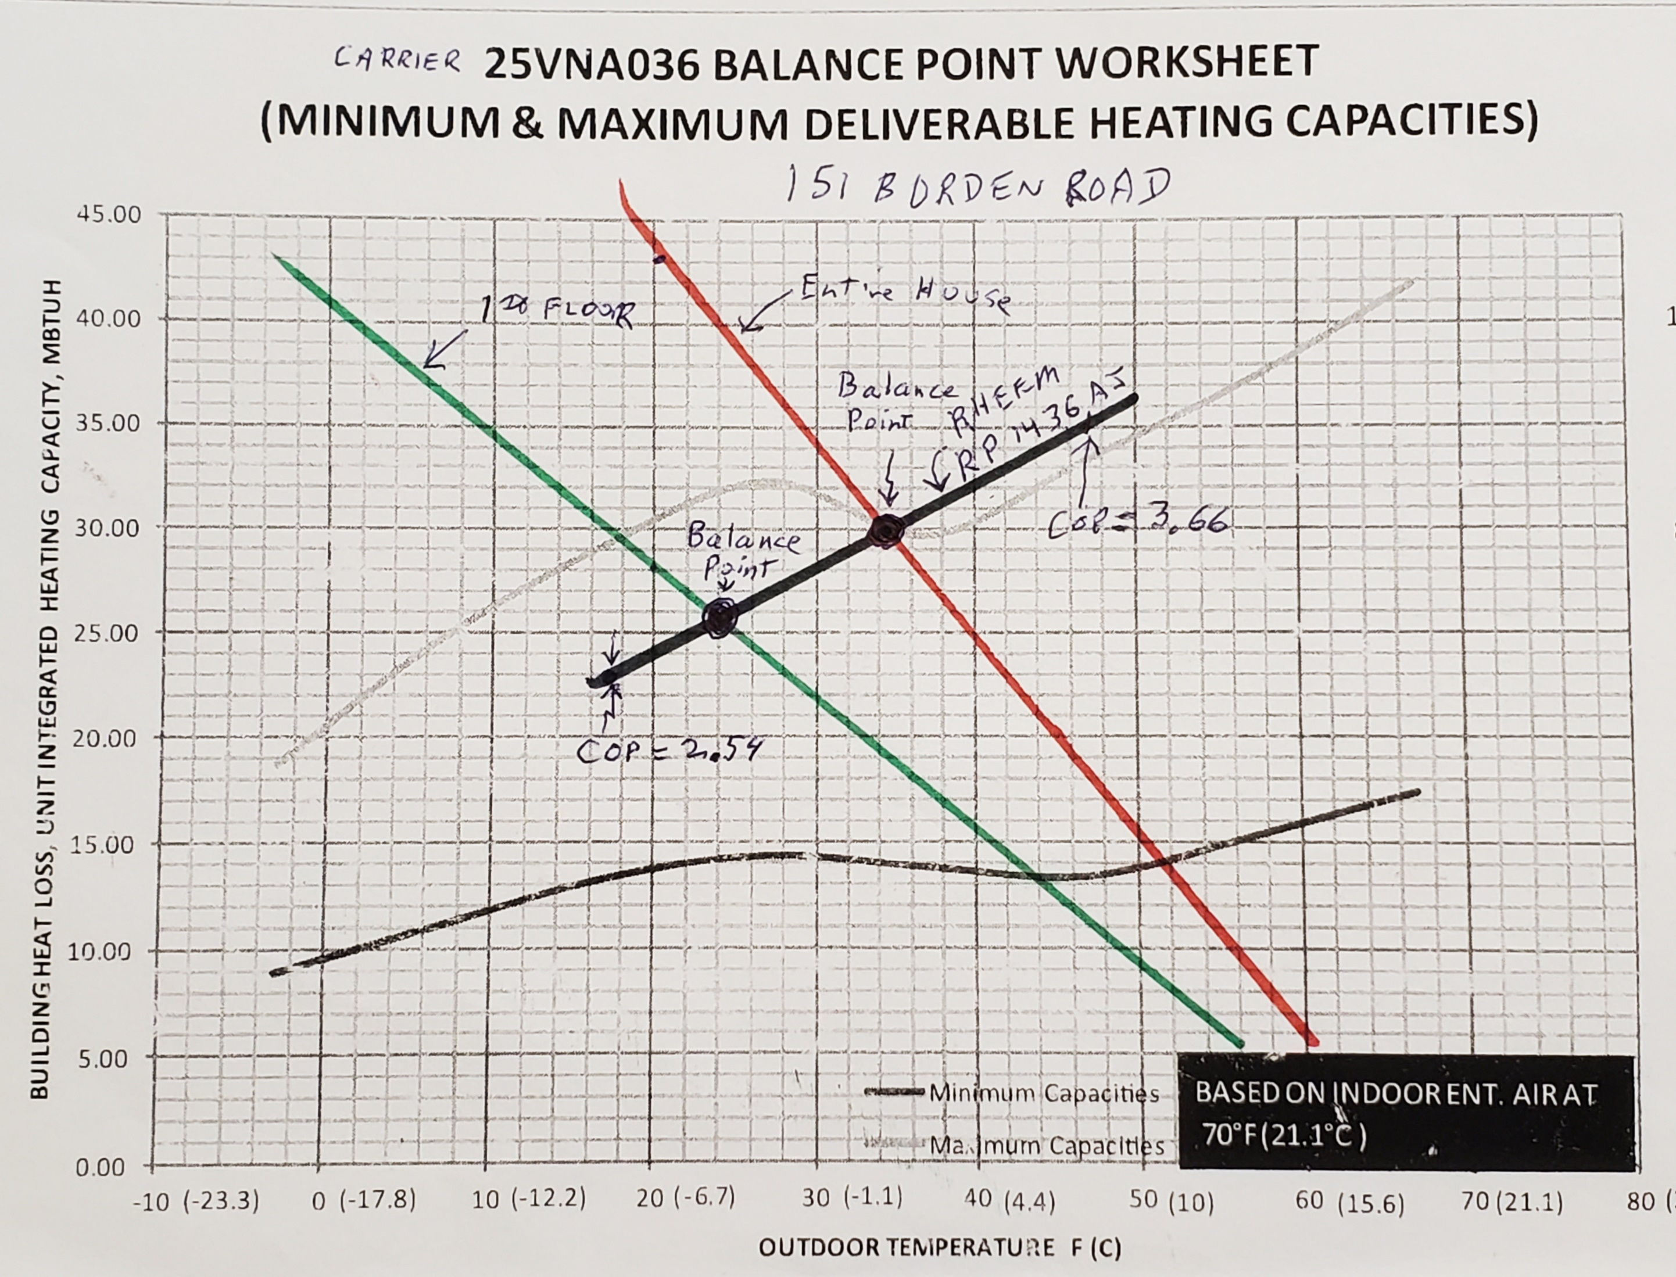
Notes:
I did this calculation more than 2 years ago, for my house. This allowed me to select a RHEEM heat pump for my house.
The RED straight line is the actual gas usage to heat my entire house (measured on left vertical axis in 1000 BTUS per hour).
The Green line is the estimated heat required for only the1st floor (and basement).
After the heat pump was installed, my actual two balance points were within 2 degrees F of balance points calculated using this chart.
This topic of how to measure a house heat loss was covered in slides 26 through 30 of the April 21, 2022 webinar, indexed at
https://climate.smiller.org/50x30/building-electrification/All-heat-pump-webinars.html

Slide 11
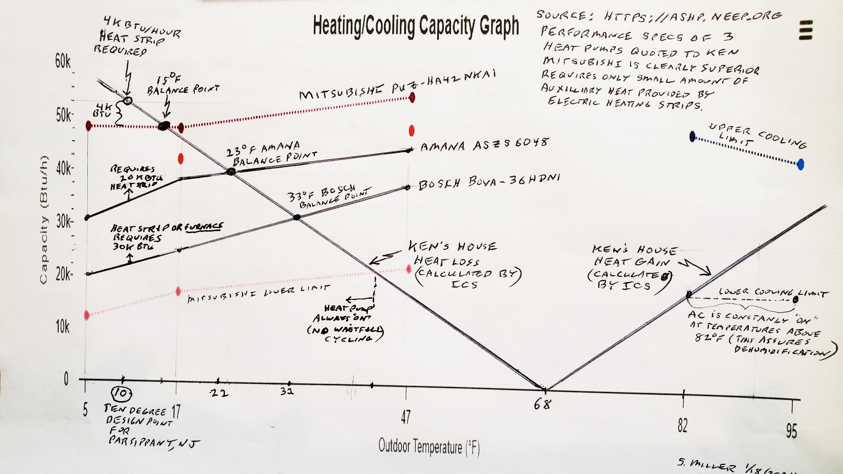
Notes:
Proposals from the vendors for replacement of Ken’s furnace and A/C
This chart provides the balance points. At ambient temperatures below the balance points, the heat pump is unable to provide sufficient heating, and a supplementary heating source is used-+
The dotted lines are technical specs for the winning bid- the MITSUBISHI PUZ Hyper heat pump, bid by Chris Wisneiwski, owner of ICS, serving metro NJ-NY area.
The heavy black line is the heat loss of Ken’s house (and the corresponding summer heat gain is also shown on the right). In this case, the heat required to keep the house cozy is 52K BTUs per hour (calculated by Chris Wisniewski, of ICS). This line can be either calculated or measured heat loss for the house.
CALCULATED: Typical contractors use “Manual J” software (or equivalent) which requires entering characteristics of the house, including the year of construction, where that year’s building code is an indicator of how tightly the house is built.
MEASURED: An accurate alternative is to measure the gas consumption during coldest part of winter. The thermal energy of gas burned to heat the house is an EXCELLENT measure of the heat required to keep the house at the desire temperature.
The “balance point” is the ambient temperature (bottom scale) where the heavy line crosses the maximum spec of the heat pump.
On left is the heat strip required, at 10 degrees design point. Amana and Bosch require MUCH larger heat strip ratings (a gas furnace would be the fast/easy/profitable solution -proposed by MANY/most? HVAC contractors) instead of large heat strip, heavy electrical wire and resulting high electric bills
One reference to “design temperature” (identified for each NJ county) is “Energy Star Single-Family New Homes; Energy Star Multifamily New Construction Design Temperature Limit Reference guide (2019 Edition)”

Slide 12


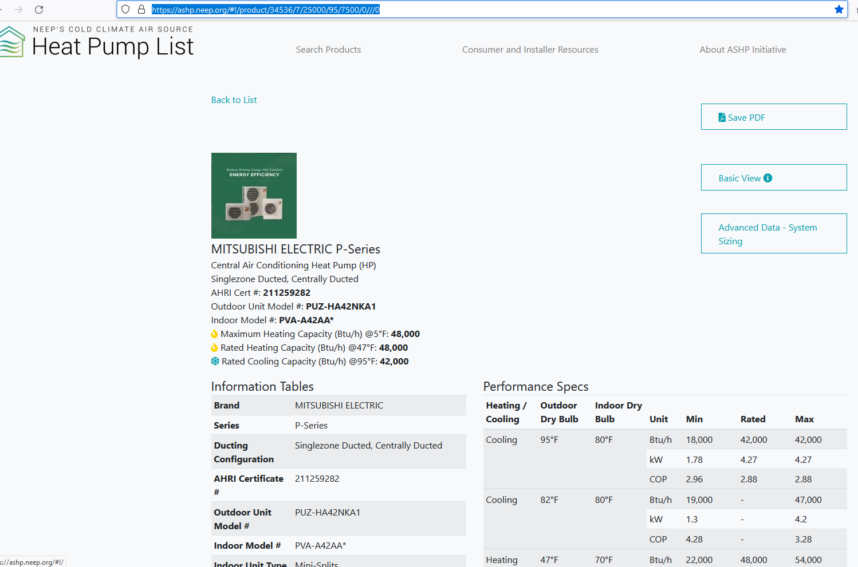
https://ashp.neep.org/#!/product/34536/7/25000/95/7500/0///0
Notes:
This is an example page from the NEEP web site https://ashp.neep.org
which indexes all heat pumps suitable for NJ climate zones 4 and 5.
All important specs are identified. Scrolling down shows graphs of heating and cooling performance.
Heat pump models with meet energy star are identifiedl

Slide 13
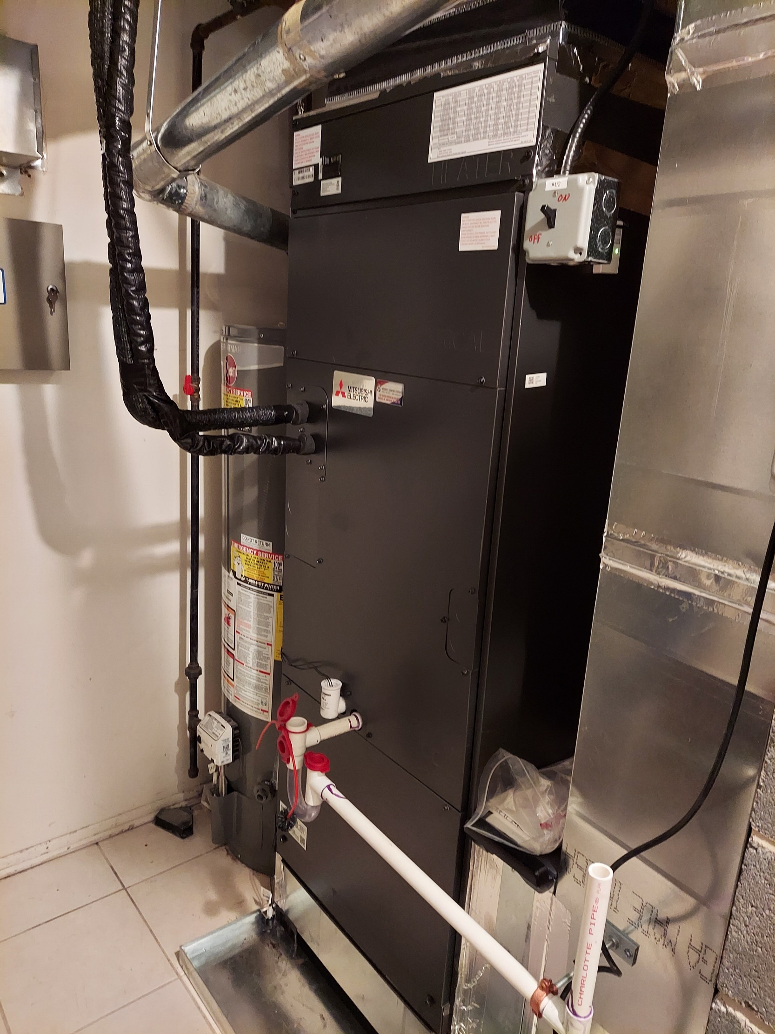
Notes:
Ken’s new heat pump (indoor unit)
In the rear is a gas-powered water heater. Heat pump replacements were discussed. View the recording, and read the Q&A/Chat file for important comments about heat pumps for both space heating and water heating.

Slide 14
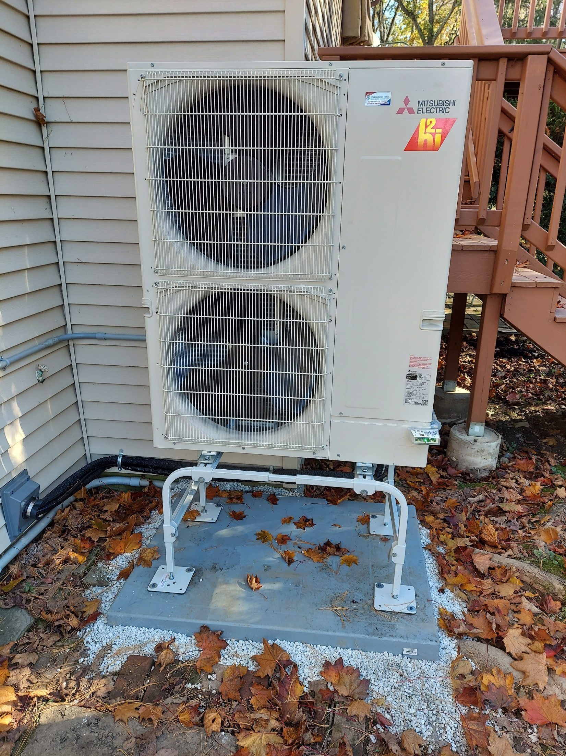
Notes:
Ken’s new Mitsubishi heat pump (outside unit), which replaces the original Air Conditioner. The heat pump is on stilts to avoid deep snow drift from blocking air flow.
Horizontal (rather than vertical) air flow helps prevent snow/ice/debris blocking air flow.

Slide 15
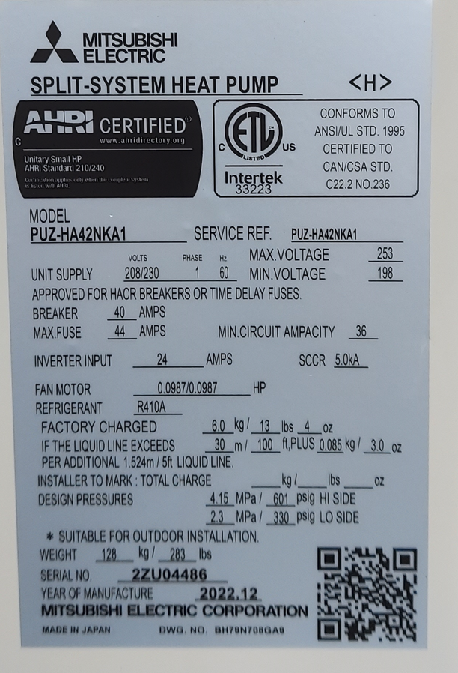
Notes:
Each heat pump unit (inside and outside) contains a label with detailed specs.

Slide 16
THANK YOU FOR JOINING OUR 24TH MONTHLY BUILDING ELECTRIFICATION WEBINAR
Join our next Building Electrification webinar on Thursday, Feb 15 Building at 7PM
The speaker, Betsy, is a recent graduate (awarded a certificate of completion) of Rewiring America’s “Electrification Coach” training. Betsy will describe the course content and how she can apply it to help NJ residents weatherize/insulate/heat and cool their house with heat pumps. Our hope is to create a sizeable group of trained volunteers to advise and stimulate heat pumps installations in NJ homes and small businesses
REGISTER AT https://bit.ly/3tmyd1g

